Slide 1

Medino Pharmacy
Daisyna SHRESTHA
NCC-ID: 00172899
Subject: Computing Project
Date: 23rd April, 2019

Slide 2
Introduction
Medino, a web-based pharmacy management system.
Also known as drug information system.
Enable user to access medicine information from anywhere through online and purchase them.
Easy handles data and reduce paper work.
User-friendly and reliable.

Slide 3
Existing system
It requires more paper-work.
Less secure for data storage.
Manual calculation resulting budget error.
Lack of drug knowledge.
Difficulty for user in finding their required medicine.
Less reliable for correct medication

Slide 4
Background of the project
Both pharmacist and user can login into the system with unique email address.
Adding, updating and deleting medicine information are managed by pharmacist.
User can search and view medicine detail and can place their order.
Automated bill generation.

Slide 5
Aims and Objectives
Computerized pharmacy system.
Manage and maintain daily activities of pharmacy.
Secure data processing and storage.
Less paper work.
Overcome manual efforts.
Enhances efficiency.
Easy placing order.

Slide 6
Features of the project - 1
Pharmacist and user login
Store medicine and its related information
Modify and delete medicine
Effective search of medicine
Display extensible list of available medicine
Upload prescription report

Slide 7
Features of the project - 2
Order medicine
Auto generate bill, save and print bill
Record customer order
User-friendly

Slide 8
MOSCOW Prioritization
MoSCoW prioritization is a technique to understand the relative importance of the work to be done.
It helps to make progress and keep deadlines.
And MoSCoW stands for:
Must Have
Should Have
Could Have
Won’t Have this time

Slide 9
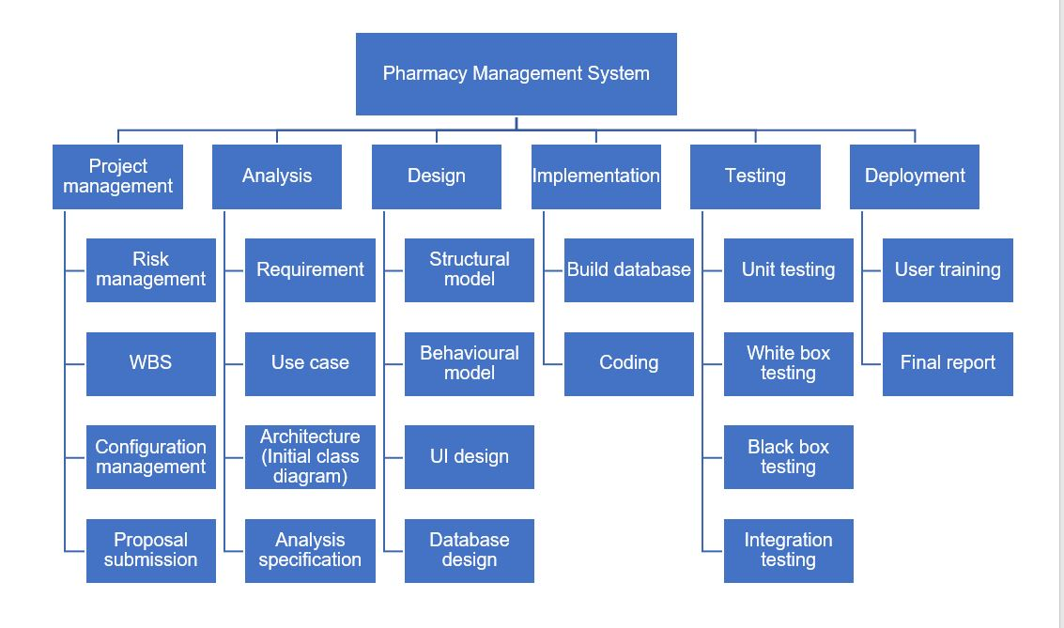
Work breakdown structure

Slide 10
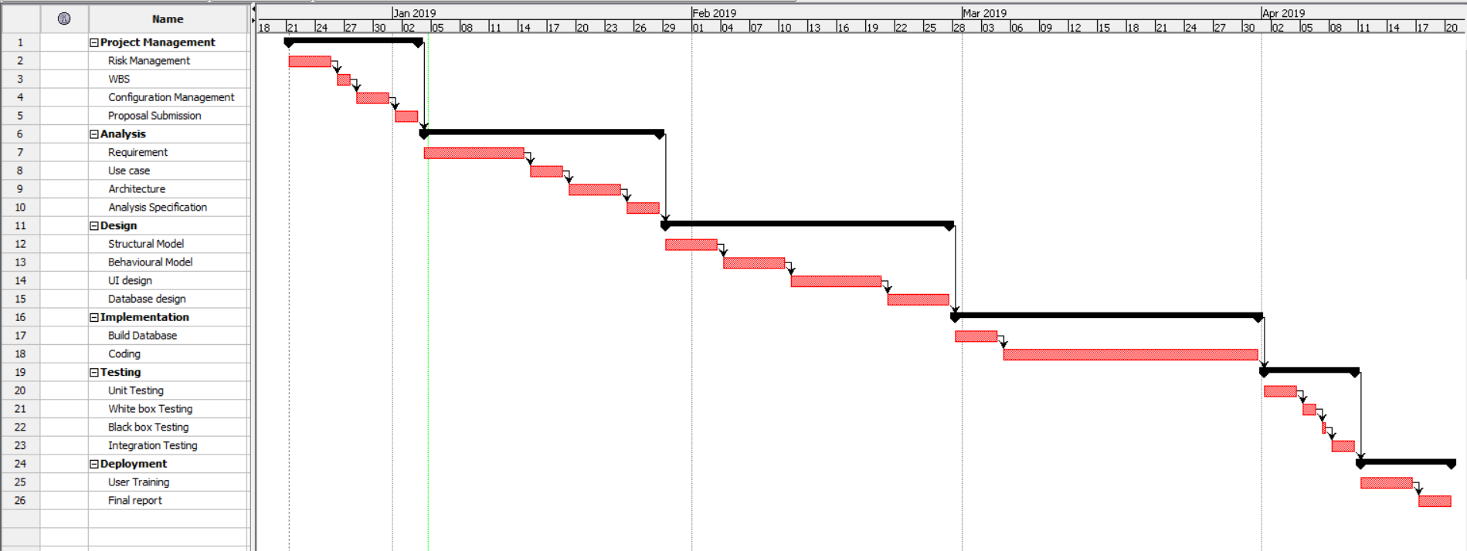
Gantt Chart

Slide 11
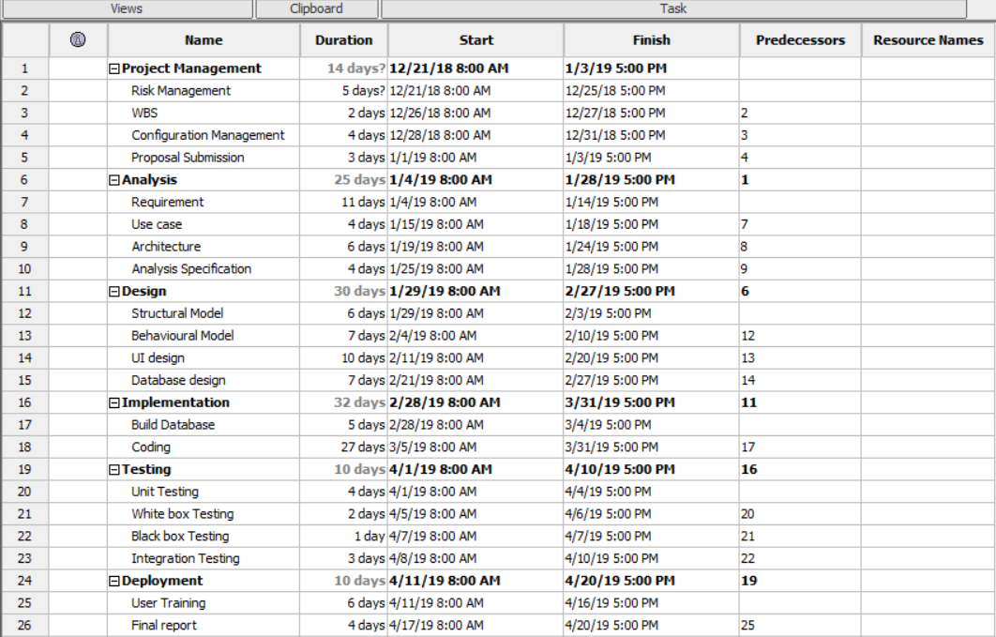
Scheduling

Slide 12
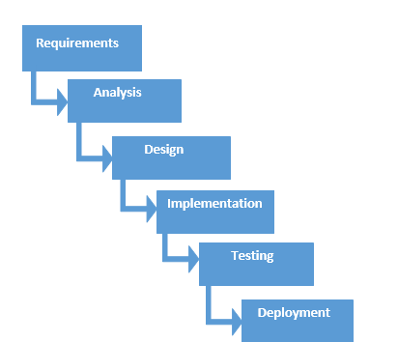
Waterfall methodology
It is linear-sequential software development model in which development is seen as flowing steadily downwards like a waterfall through phases.
Each phase must be completed before beginning another phase.

Slide 13
Why Waterfall ?

Slide 14
Architecture

Slide 15
Risk management

Slide 16
Configuration management

Slide 17
Design – initial class diagram

Slide 19
Design – class diagram

Slide 21
Design – Er-diagram

Slide 23
Design – Use case diagram

Slide 25
Design – activity diagram

Slide 29
Design – sequence diagram

Slide 33
Coding and its ui design

Slide 37
Test cases

Slide 38
Future work

Slide 39
Limitation

Slide 40
User manual

Slide 41
conclusion

Slide 42
references

Slide 43
Any question ?

Slide 44
Thank you !

